Slide 1
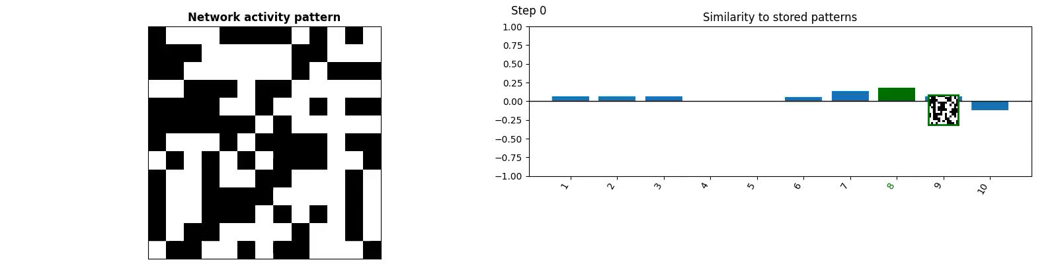
Modelling the hippocampus: Associative memory
Part 1
TReND Computational Summer School

Slide 2
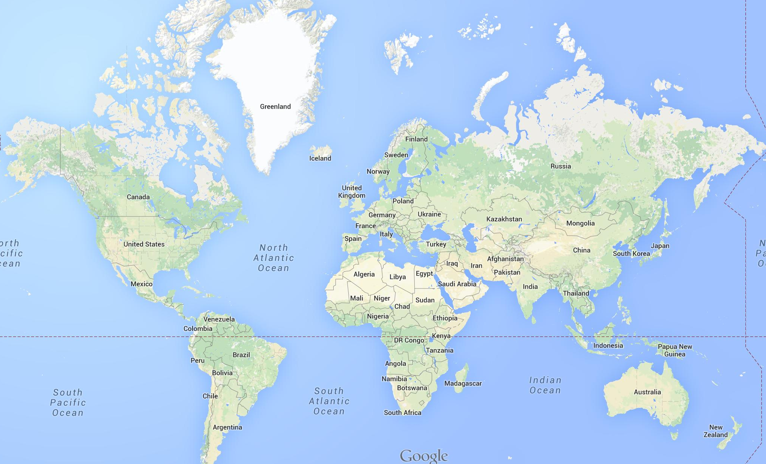






I have travelled far and wide…within the south of England
Winchester, UK
Cambridge University, UK
University College London, UK
Harvard University, USA

Slide 3






“Tom George, Cambridge University”
I, too, am a decorated rower

Slide 4
The grand plan for this morning…
Today we’ll learn about the Hippocampus
It’s role in memory
Lecture (30 mins)
Tutorial (1hr 30)
Break
It’s role in spatial navigation
Lecture (30 mins)
Tutorial (1hr 30)

Slide 5
Aims:
Introduce the Hippocampus
Explore its role in memory
Learn about associative memory networks
Understand how an associative memory network stores memories in their weight matrices
Explain what is meant by the terms content-addressable, pattern completion, error correction and interference
Understand how these networks can be trained and their limits
Describe how the anatomy of hippocampal region CA3 is consistent with models of associative memory
Tutorial: Building Hopfield Networks

Slide 6
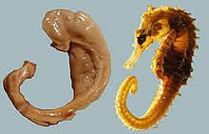

What and where is the hippocampus
Tucked into the centre of the brain, cashew-nut shaped region
Integration hub receiving inputs from all over cortex
Very well studied!
Implicated in memory (part 1) and spatial navigation (part 2)

Slide 7

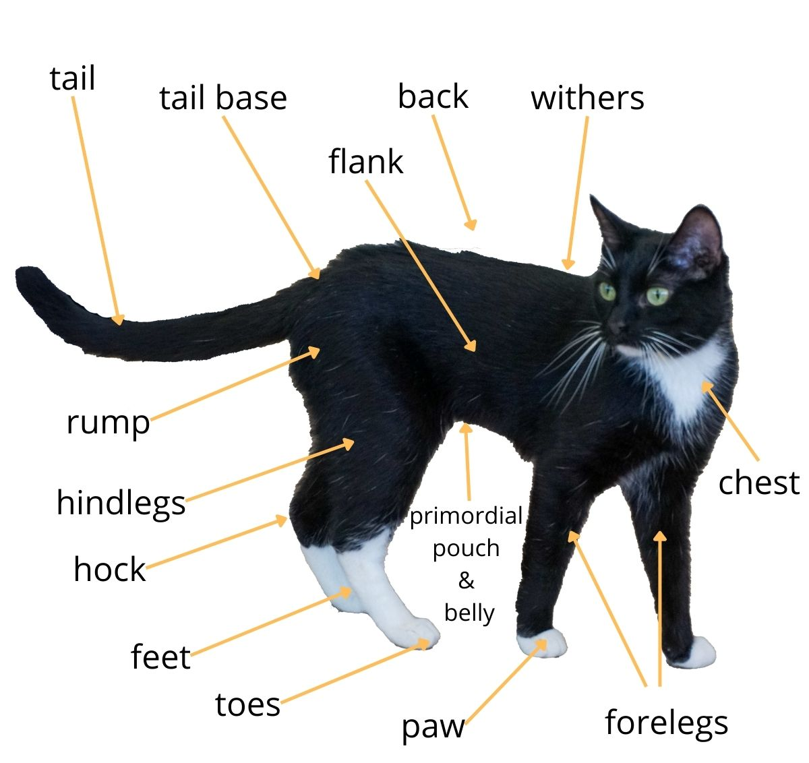
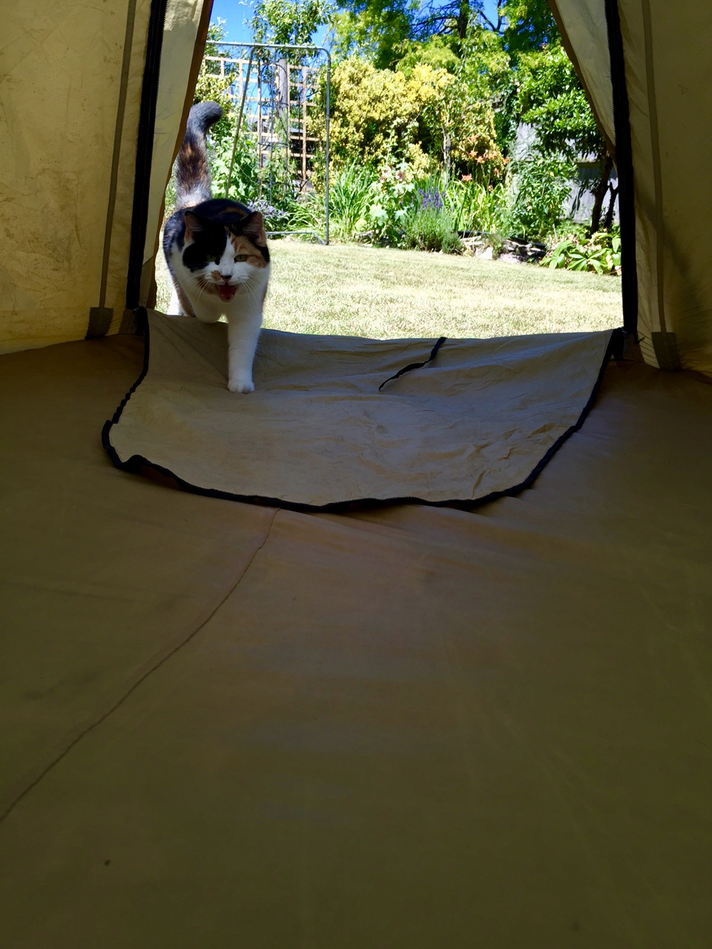


There are different categories of memory
Human memory
Long term memory
Short term memory
A name at a party
A telephone number
Imagining things
Declarative memory
Non-declarative memory
this lecture does not live here!
Motor skills
Habits
Emotional responses
Episodic memory
Semantic memory
Events
Times
Geography
Meanings of words
Facts
Associations
We think Hippocampus is important for declarative memory
Cohen (1981)

Slide 8
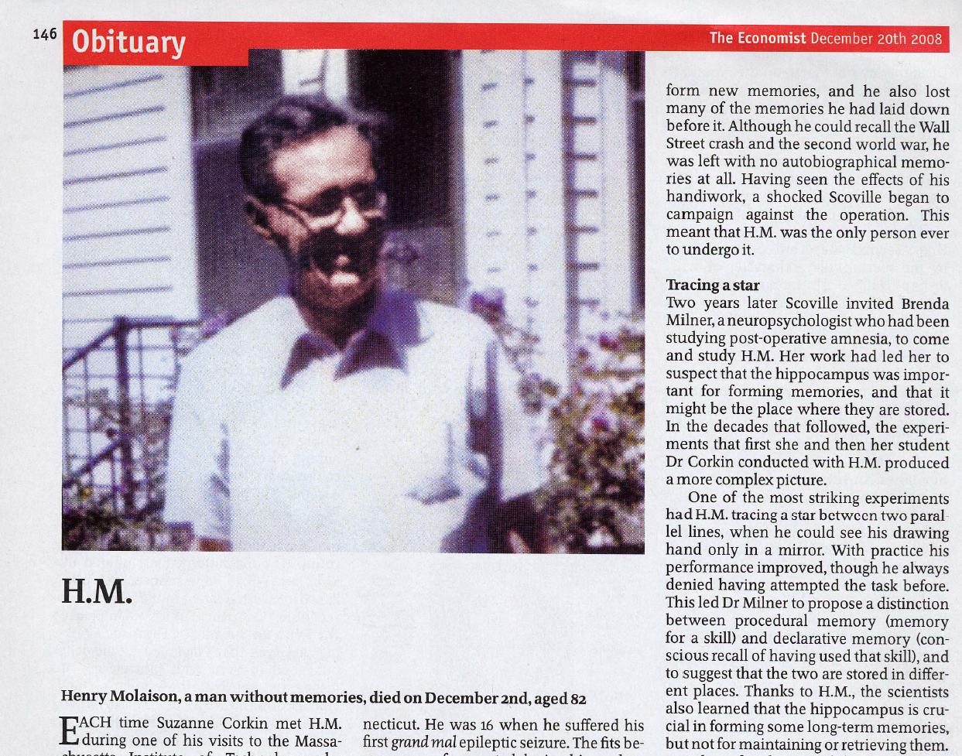
HM: A man without memories

Slide 9
Patient HM had a hippocampal lesion
Severe epilepsy: treated by surgery to bilaterally remove medial temporal lobes…
…including amygdala, entorhinal cortex and anterior hippocampus
Surgery in September 1953 (age 27)
Memory retested in April 1955 (age 29)
Results:
No new memories formed since operation
but his IQ had actually improved (!)
Scoville and Milner (1957)

Slide 10
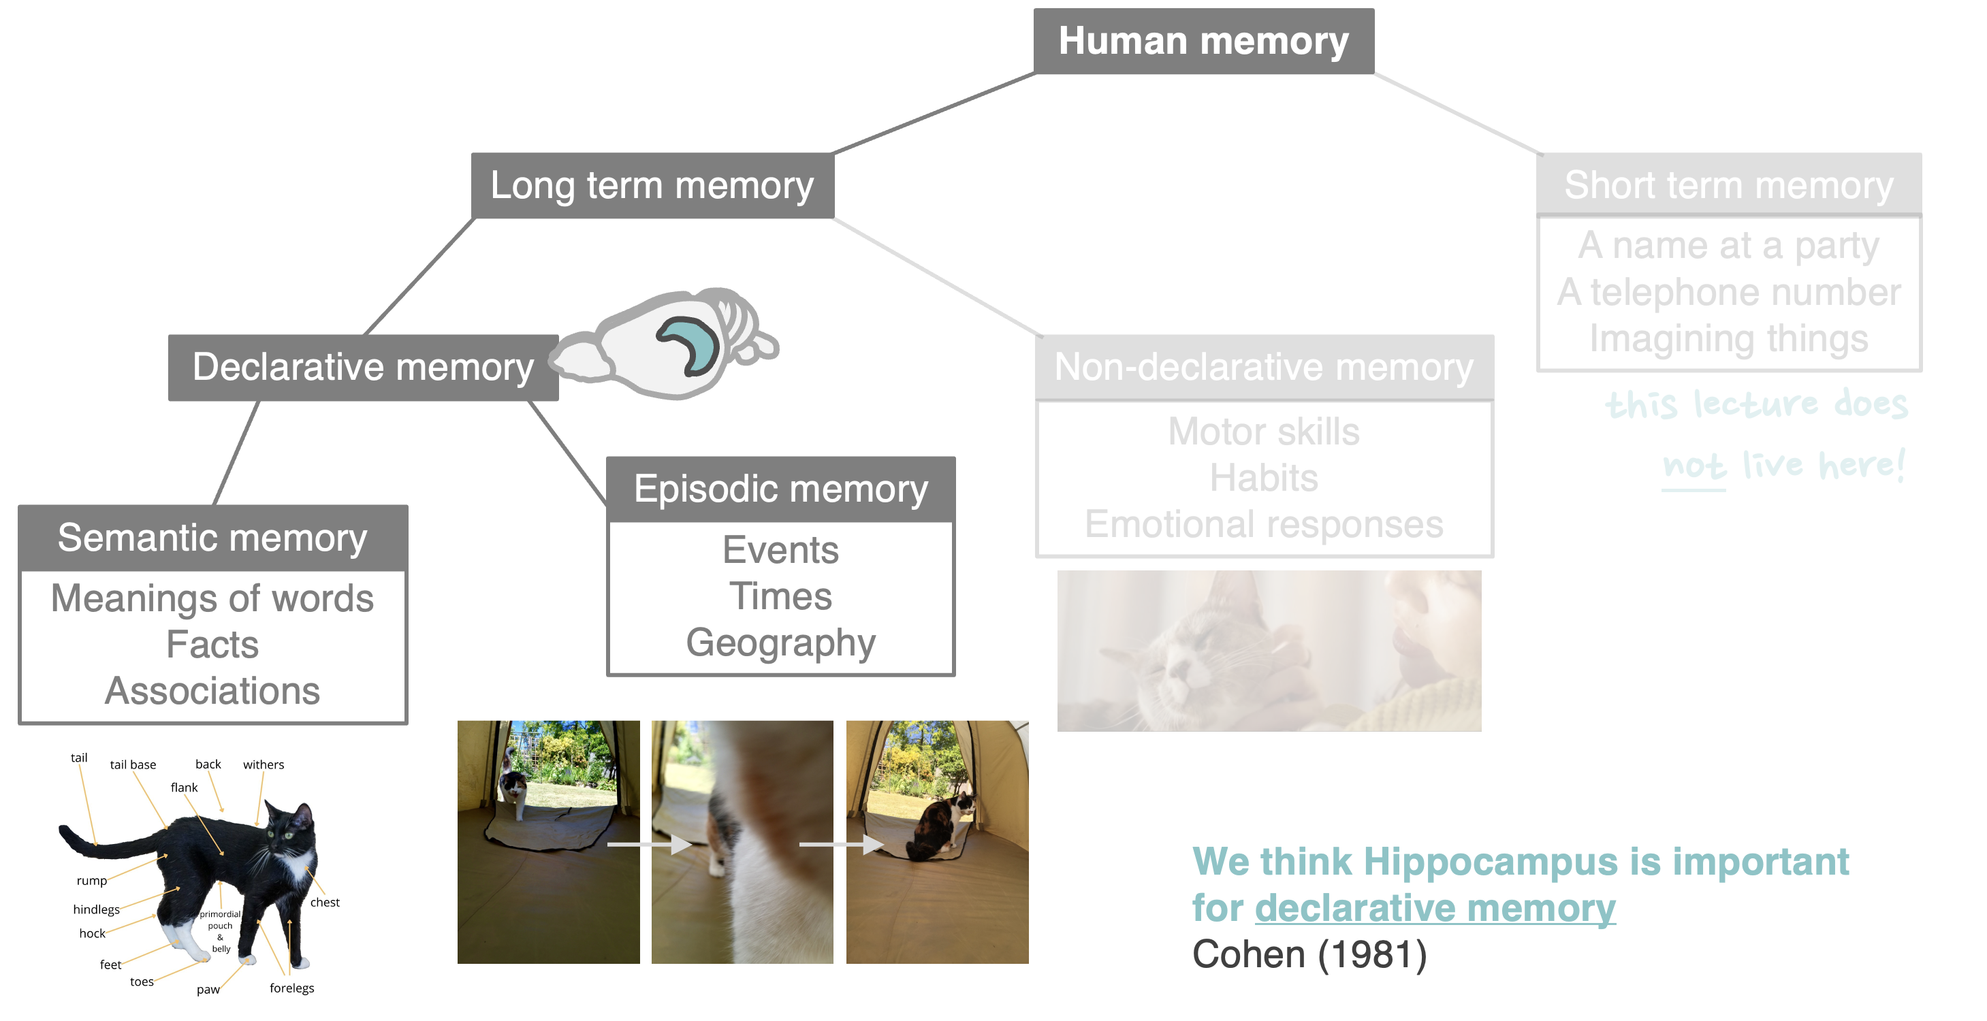
Patient HM
Impaired episodic memory:
Can’t remember location of is new home
Can copy but not recall drawings
Doesn’t remember anyone new since the operation
Impaired semantic memory:
Can’t remember new words (with the exception of “rock ‘n’ roll”)
Non-declarative memory (motor skills, short term memory) was relatively unimpaired
Impaired declarative memory

Slide 11
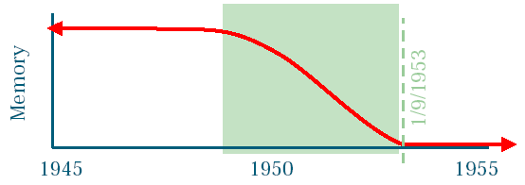
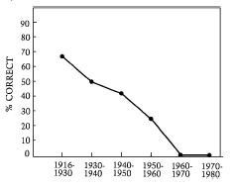
Date of operation
This lead to the hypothesis that:
Hippocampus is necessary to form new memories and consolidate them to long term storage but is not, itself, the location of long term storage
Temporal gradient in retrograde amnesia

Slide 12

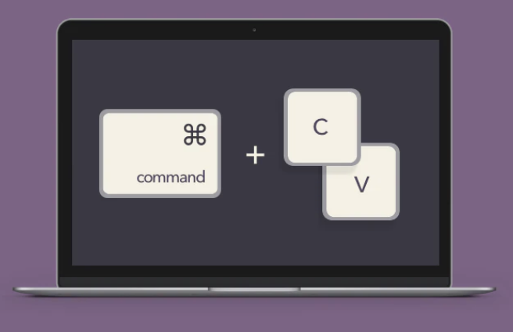
A useful analogy…
Computer Clip Board
Computer Hard Drive
Hippocampus
Cortex

Slide 13
So hippocampus has two memory roles:
Make and retrieve new memories
• Auto associative networks, CA3
Memory encoding
Send memories to long term storage in cortex
Sleep, “replay”
Memory consolidation

Slide 14
Fast and slow learning
Hippocampus is well placed to receive sensory data from all over cortex, combine them into “memories”, and then slowly consolidate them to neocortex
Hippocampus:
Neocortex:
Model
Hippocampal recurrent collaterals for rapid (‘one-shot’) associative learning
Slow learning in neocortex, trained by hippocampus
Issues
Transfer vs training?
Timescale? One night or twenty years → graded retrograde amnesia?
Generalisation / abstraction of meaning: episodic → semantic memory?
Marr (1971); Willshaw and Buckingham (1990); Alvarez and Squire (1994); McClelland et al. (1995)

Slide 15
Summary so far:
Hippocampus is an integration centre, receive input from many sensory brain regions
It is important for declarative memory
Without the hippocampus new memories cannot be formed, old memories are preserved
Hippocampus therefore rapidly encodes new memories and slowly consolidates them into neocortex

Slide 16


How do networks of neurons store memories?
We take memory for granted….what would it even mean for a network to “remember”
Content addressable memory:
Give a partial memory → Complete the memory
e.g. Recalling memories, pattern completion, search engines
Random access memory:
Give an address → Return the data
e.g. Computer memory, using a library
an example of content addressable memory

Slide 17
Hopfield networks for Auto-associative memory
Fully connected recurrent neural network
No inputs or outputs
Symmetric weights between neurons
Neurons are binary: they can be either on (+1) or off (-1)
s_{i}
w_{ij}
s_{j}
Two questions:
What’s the update rule? i.e. how to the neuron values change?
How do we set the weights, w_{ij}, in order to store memories?

Slide 18
Hopfield network update rule
the new value of the neuron
a threshold function: whether the neuron receives enough input to turn on (i.e. “fire”)
how strong neuron j connects to neuron i
current value of all other neurons at time t
(1) get other neuron values
(2) get weights
(3) sum weights x values
(4) threshold
s_{i}
s_{i}
0.1
+1
0.1 x +1
+ -0.3 x +1
+ -0.3 x -1
+ 0.2 x +1
= 0.3
+1
+1
-1
sign(0.3) = +1
-0.3
+1
0.2
+1
-0.3
+1
+1
-1
-1

Slide 19
If we keep updating the neurons like this….
…then maybe the network will fall into a stable state
…
s_{i}
w_{ij}
s_{j}

Slide 20
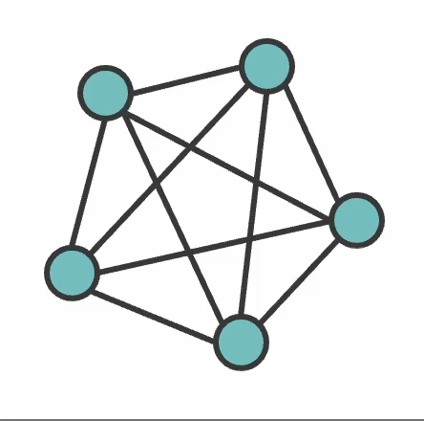
Synchronous vs asynchronous update
In asynchronous updates a random neuron is chosen at each time step and updated
In synchronous updates all neurons are updated simultaneously

Slide 21
The weight matrix can be designed to store patterns
To store a pattern the weight matrix is set to
For example (3 neurons, 1 pattern):
Its easy to see why, with this weight matrix, the pattern is a stable state of the network. Consider two neurons in the pattern:
If are both positive, (+1, +1) they have positive connection, reinforcing each others positivity.
If are both negative, (-1, -1) they have positive connection, reinforcing each others negativity.
If they are opposite (+1, -1) the connection is negative so the positive neuron inhibits the negative one, keeping it negative and vice versa.

Slide 22
Content addressable memory. Hopfield networks pattern complete
• What happens if the network starts at a pattern which is nearby to the stored one?
Answer: We recover the old memory!

Slide 23
The weight matrix for storing many pattern
Just sum together the weight matrices for at the patterns

Slide 24
Consider what it takes for a pattern to be “stable”
If a pattern is to be stable then
Connections should be positive between neurons with the same value and negative between neurons with different value
The “energy” or “frustration” of the network is how much this is not true.
Under the dynamics of a Hopfield Network the Energy function is guaranteed to decrease. Patterns are stable minima of the energy function

Slide 25
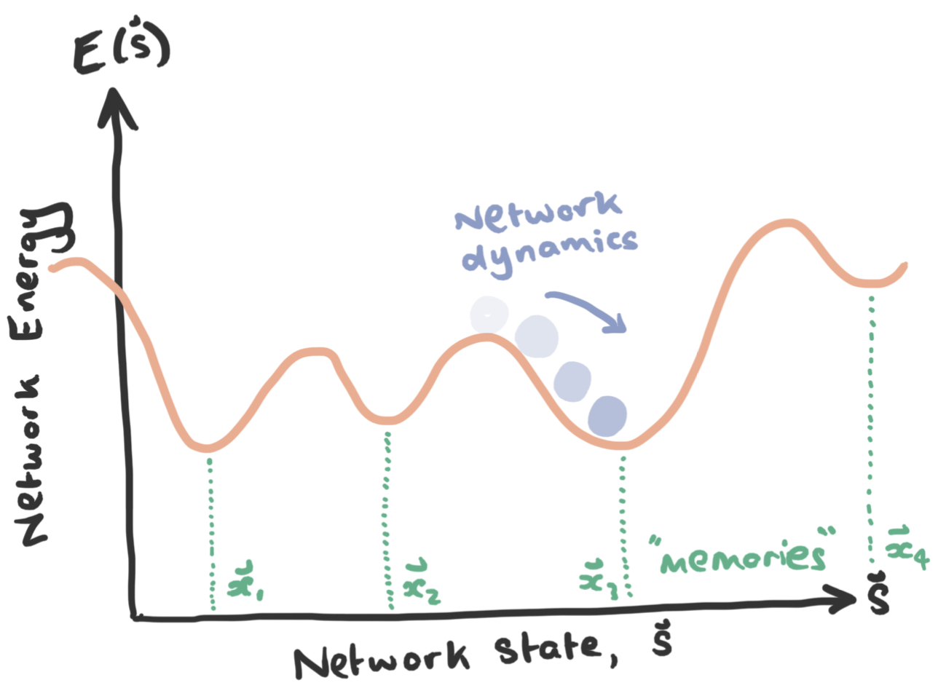
The energy landscape of a Hopfield network looks like this

Slide 26
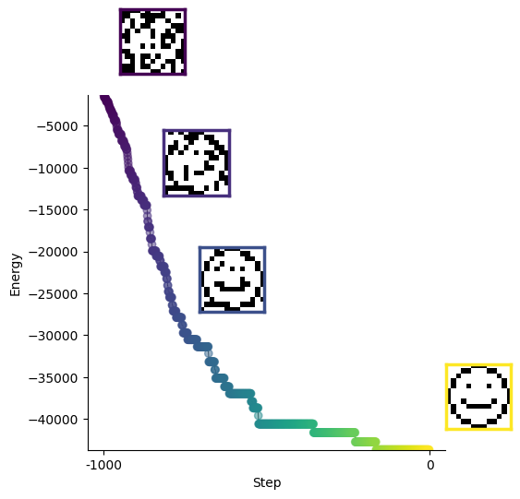

Slide 27
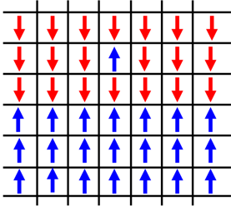
Hopfield networks got physicists excited about the brain!
Physicists have long been interested in modelling magnetism (Ising, 1925)
This involves a large number of independent “spins” which can be either up ↑ or down ↓ and interact
Sound familiar?
Hopfield’s memory model showed that principles from physics can be used to understand of the brain.
Since then many field of physics have entered neuroscience (dynamical systems, energy—based models, etc..

Slide 28
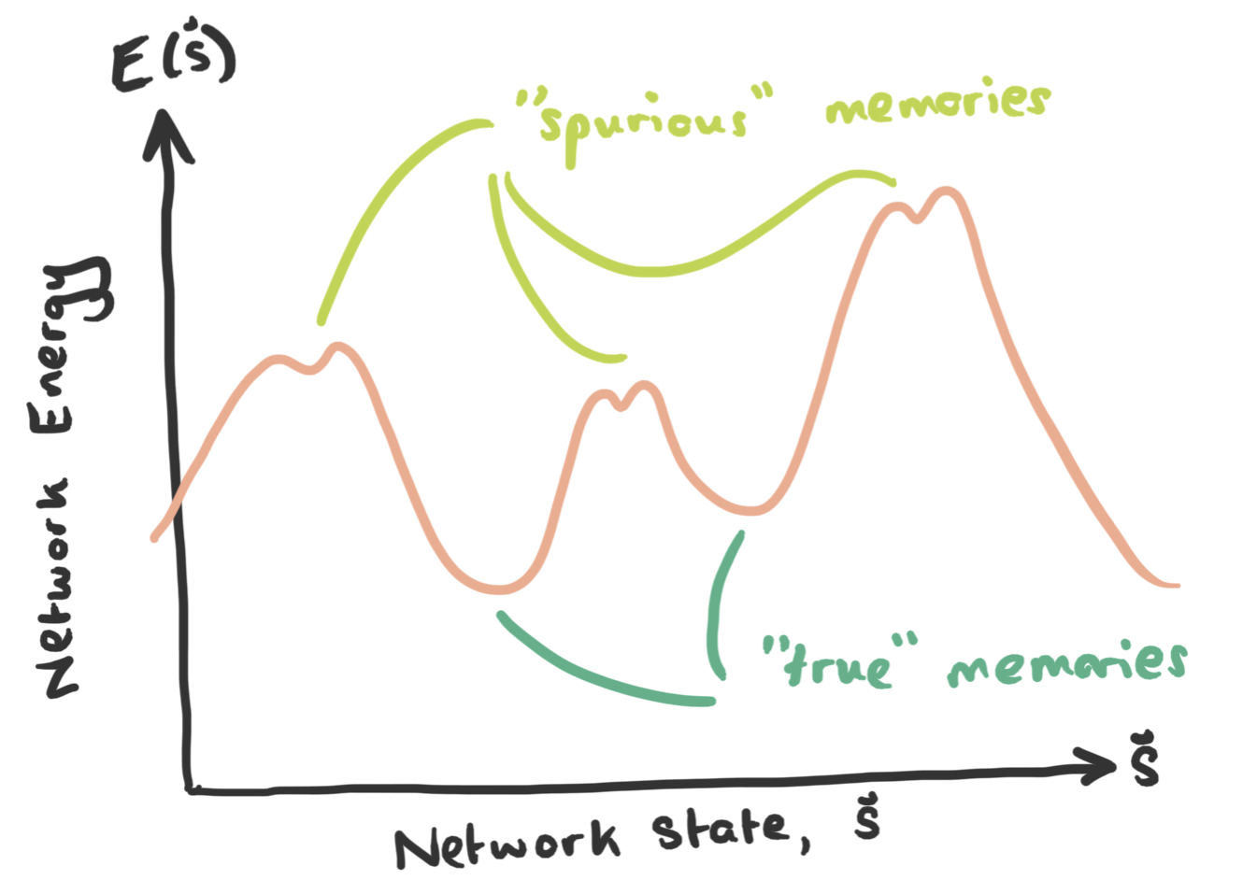
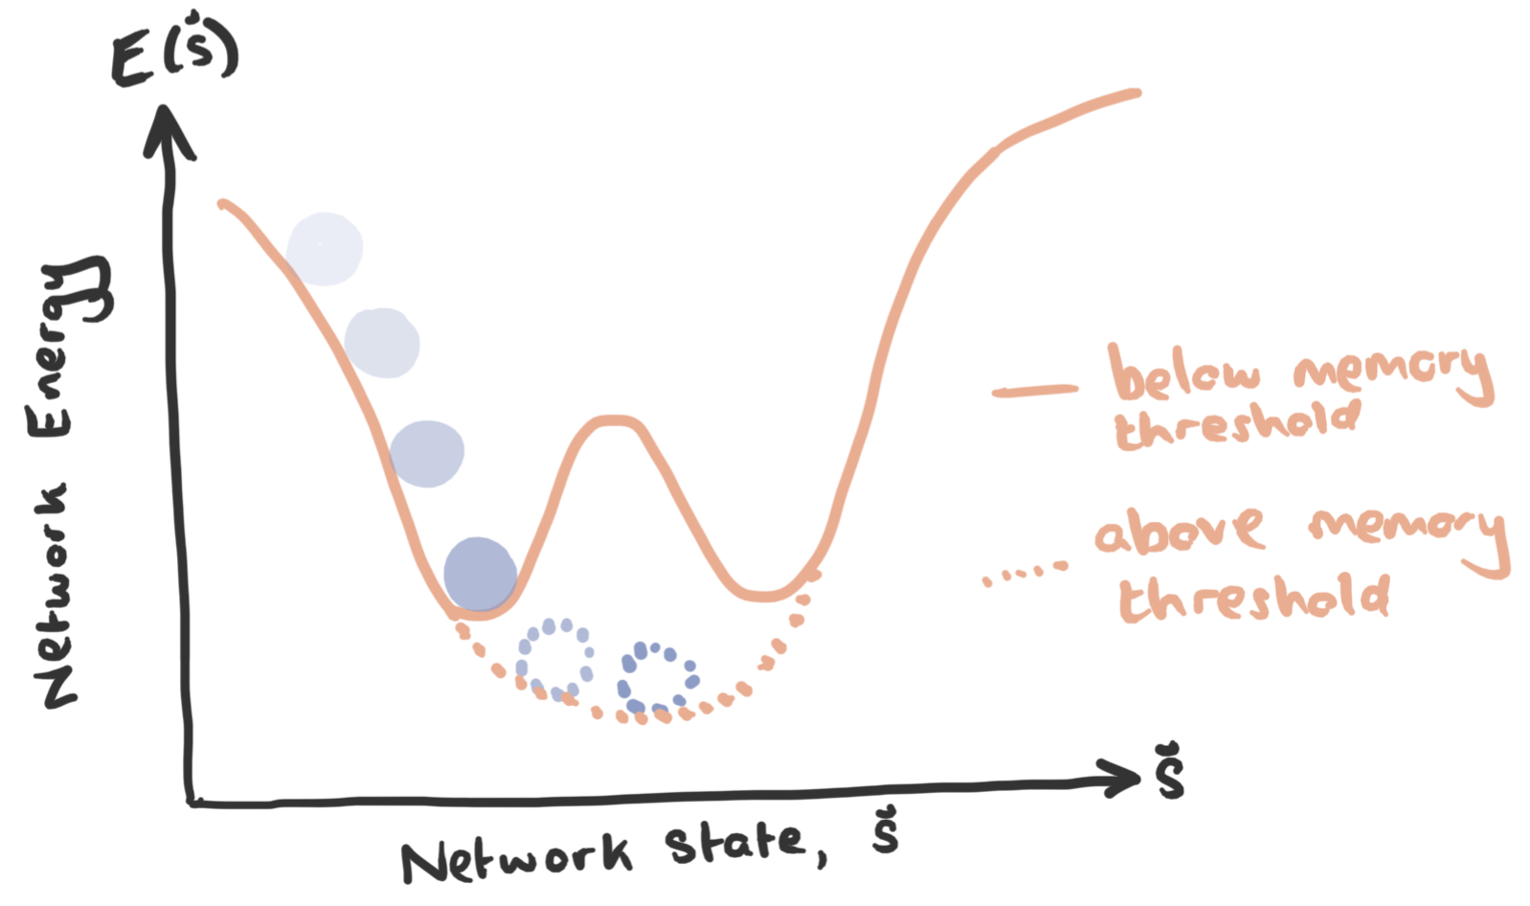
Limitations: Spurious states and memory limits
Spurious states
Negative patterns and mixtures of patterns are stable attractor states too ☹
These unwanted memories are called “spurious states”
We’ll explore these ideas further in the tutorial
Memory capacity
You can store many memories in a Hopfield network but after a while they begin to interfere.
The memory capacity is

Slide 29
How would neurons learn the weight matrix?
“cells that fire together wire together” – Donald Hebb 1949
“any two cells or systems of cells that are repeatedly active at the same time will tend to become ‘associated’ so that activity in one facilitates activity in the other”
Step 1: Impose patterns we want to memorise onto the network
Step 2: Adjust the weights according to Hebbian learning
w_{ij}

Slide 30
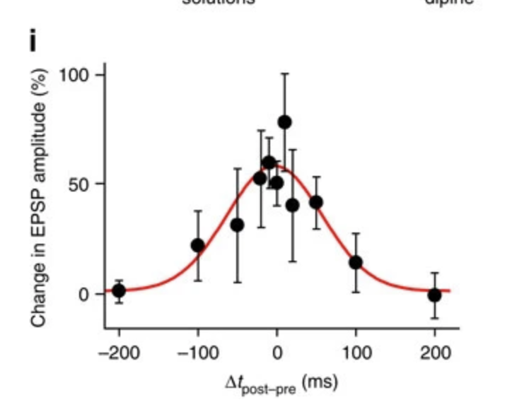
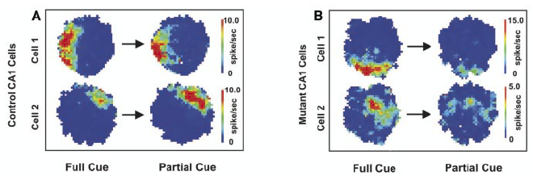
Evidence that Hippocampus is an associative memory network
Hippocampal subregion CA3 is highly recurrent
CA3 plasticity is Hebbian
Mishra et al. (2016)
Place cell firing is robust to removal of a subset of cues iff CA3 is present
Nakazawa (2002)

Slide 31
Tutorial time !
https://github.com/TomGeorge1234/HopfieldNetworkTutorial

